Slide 1
CHAPTER 2
DOM : ADVANCED
ELEMENT HIERARCHY
CSS

Slide 2

EXPLORE
DOM hierarchy
ACTIVITY 1
15 MIN
Answer to questions on word document
Notes:
Okay if the students have not finished, there are many questions.
Read the questions and explain the answer by looking at the code.

Slide 3
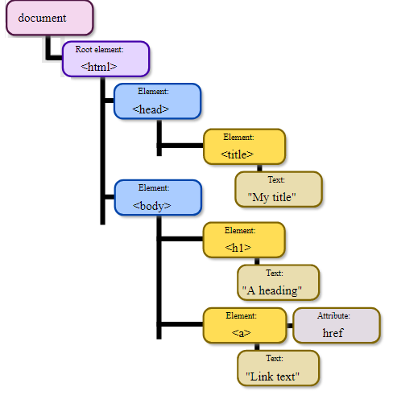
EXPLAIN
Each node has a parent, siblings , children,
Parent is above
Siblings at same level
Children are below
Notes:
Explain how to find the family members

Slide 4
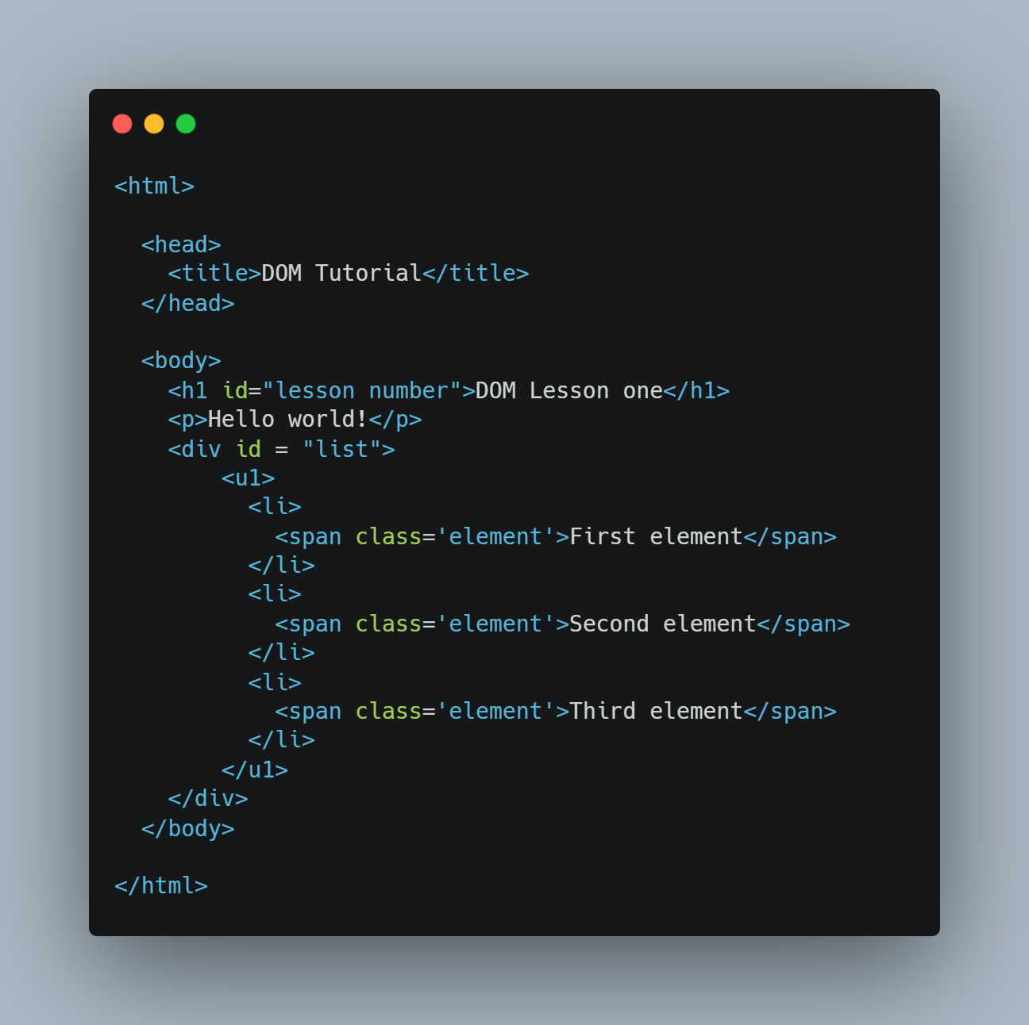
EXPLAIN
DOM is easy to read thanks to tabulations
Parent
Siblings
Selected node
Children
Notes:
How to see it in the code.
→ A well structured code makes it very easy ! (tabulations)

Slide 5
EXPLORE
Navigate the DOM
ACTIVITY 2
20 MIN
Answer to questions on word document
Notes:
Now activity to discover properties to move along the tree branches.

Slide 6
EXPLAIN
Properties to navigate the DOM
DEMO WITH CHROME
parentNode | Get the parent node of current node
childNodes[nodenumber] firstChild lastChild | Different methods to get the child nodes of current node (HTML collection of all child; first child; last child)
nextSibling previousSibling | Respectively get the next and previous sibling in the sibling collection of the current node.

Slide 7
EXPLORE
Edit the DOM
ACTIVITY 3
20 MIN
Answer to questions on word document
Notes:
Now activity edit elements.

Slide 8
EXPLAIN
Properties to edit the DOM
document.createElement(name) | Create an HTML element of the name type (example : p, div…) and returns it
element.appendChild(child) | Add child as a child node of the element
DEMO WITH CHROME
Notes:
A demo is just the slide below.
See first example : https://www.w3schools.com/js/js_htmldom_nodes.asp

Slide 9
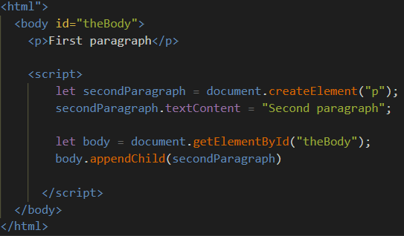
EXPLAIN
Add a new element
1-Create a
element
From the document
2- Add this
element
To an existing parent

Slide 10
EXPLORE
Practice !
ACTIVITY 4
30-40 MIN
Answer to questions on word document
USE THE CHEAT SHEET

Slide 11

Now you should know this:
1- The DOM tree Hierarchy
- Childs
- Parent
- Siblings
2- Properties of a Node to navigate the DOM
- parentNode
- childNodes[nodenumber]/firstChild/lastChild
- nextSibling/previousSibling
3- Functions to add elements to a doc
- createElement
-appendChild
4- The process to add new elements
1. Create the element
2. Append your element to the target node

